Slide 1

Supply Chain Analysis

Slide 2





Team Members
Yasmeen Osama
Fatima Al zahraa
Zainab Ahmed
Mohamed Elyamany
Data Modeling
Shipping insights & Dashboard
Data Modeling
Finance insights & Dashboard
Data Cleaning
& Modeling
Orders insights & Dashboard
Data Modeling
Overview insights & Dashboard

Slide 3




Table Of Contents
Introduction
4
Insights & Findings
1
2
Business Question
5
Visualization
3
Analysis Steps
6
Recommendations

Slide 4


Introduction
The supply chain is a series of interconnected processes that move products from suppliers to customers. It includes sourcing, production, storage, and distribution. Effective supply chain management is vital for companies to meet customer needs and stay competitive in a fast-changing market.

Slide 5

Project Objective
The goal of this project is to analyze the supply chain, identify inefficiencies, and propose solutions to improve efficiency, Identify Key Drivers of Sales and Profitability through data-driven insights.

Slide 6


Business Questions
How efficient are shipping and delivery processes?
What is the profitability of orders?
Which geographic areas are the most active?
What are the key challenges facing the supply chain?
How is the quality of customer service?

Slide 7

Analysis Steps
Data Collection
Data Analysis
Data Cleaning
Exploratory Data Analysis (EDA)
Data Model

Slide 8


Data Collection
We have collected data files in Excel format from various sites like:
Kaggle
GitHub
Google Dataset

Slide 9

Data Cleaning
Data Volume: Thousands of records representing flights over a specified period.
Common Issues Detected:
Missing Data
Errors
Duplicates
Data Type Mismatches: Certain columns may have incorrect data types (e.g., times stored as text).

Slide 10
Data Modelling
We divided the data into:
Fact table
six dimension tables:
Dim_Customer Dim_Order Dim_Date Dim_Shipping Dim_Department Dim_Product
organized in a Star Schema format, within Microsoft SQL Server, using the following code:

Slide 11
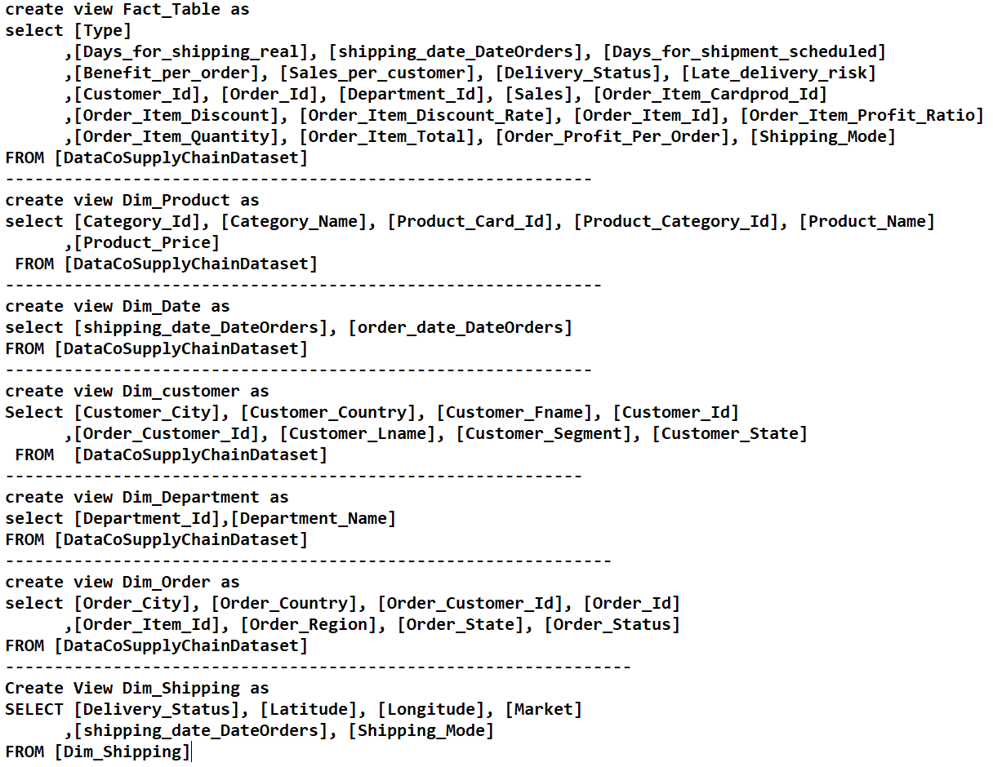
Data Modelling

Slide 12
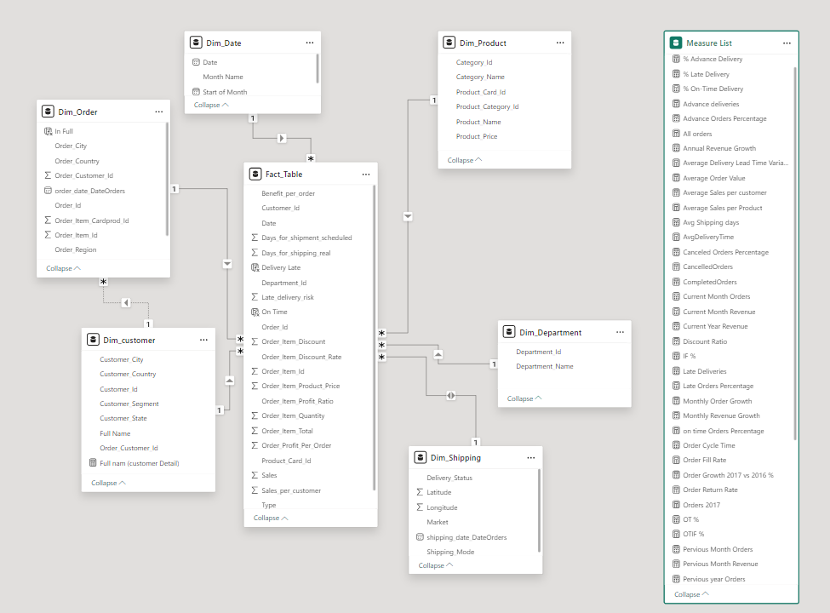
Data Modelling

Slide 13
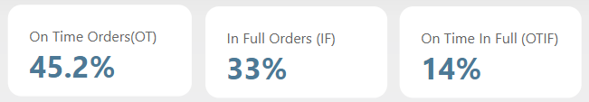
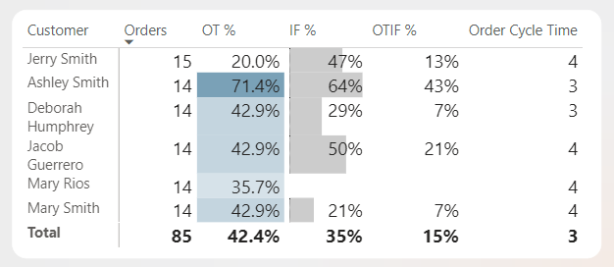
Overview Insights
According to the key performance measures we have taken, we have reached:
On Time Orders Rate (OT): 45.2%
The rate of 45.2% is low compared to industry standards in supply chains, which may indicate problems in planning.
In Full Orders (IF): 33%
This means that only about one-third of orders are delivered in the required quantities, indicating challenges in inventory or production management.
On Time in Full (OTIF): 14%
This percentage means that only 14% of orders are delivered on time and in the correct quantities, which is a serious indicator of a breakdown in supply chain performance.

Slide 14
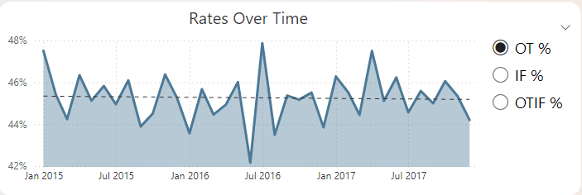
Overview Insights
The highest value achieved by On Time Rate over the past three years is 48%.
In the second quarter of 2016, the company experienced its lowest On-Time delivery rate, with only 42% of orders being delivered on schedule.
But in the third quarter, this was dealt with and there was a noticeable increase in the on-time delivery rate, which reached 47.9%

Slide 15
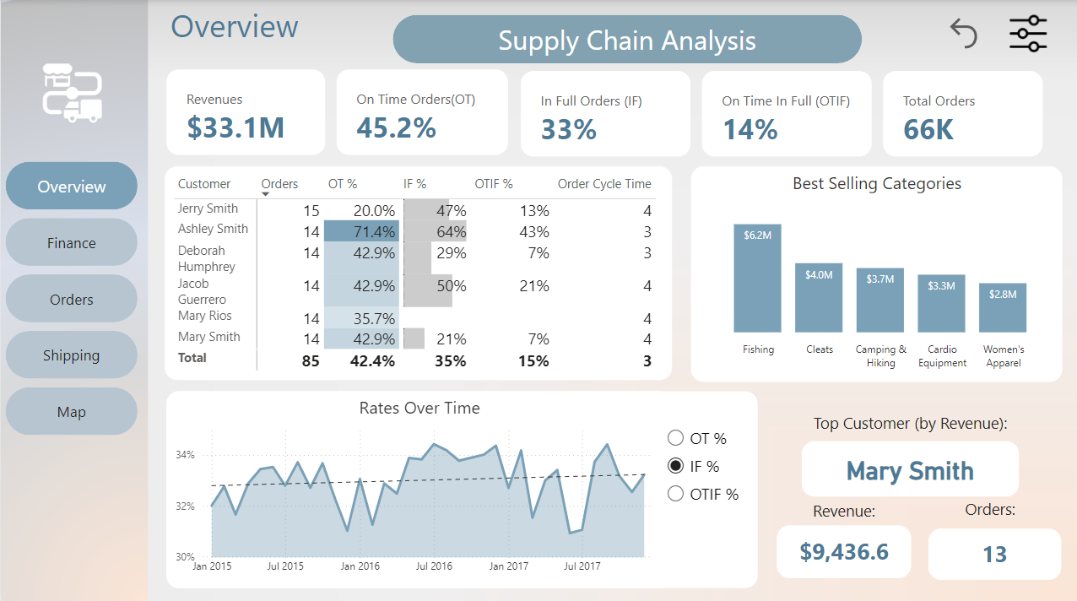
Overview Recommendations
Improving the efficiency of inventory management and logistical operations to reduce processing and shipping times
Improve demand forecasting accuracy by using modern data analytics tools that rely on artificial intelligence and machine learning.

Slide 16
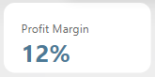
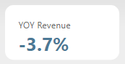
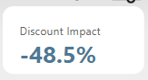
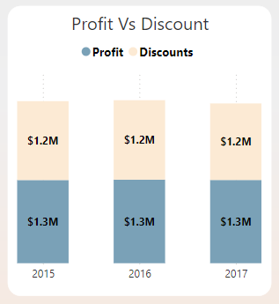
Finance Insights
These charts display:
The discount's impact on profit is -48.5%, a significantly high percentage, which affects the profit margin, making it 12%.
This chart indicates that the discounts are close in size to the profits, which is considered a revenue loss.
Even after applying this policy for over a year, the revenue rate in the last two years was -3.7%.

Slide 17
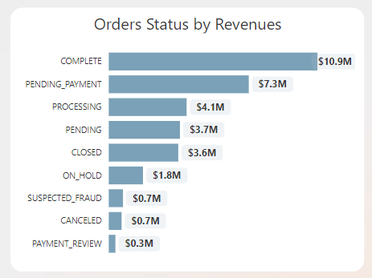

Finance Insights
Completed orders show the highest revenue compared to other cases.
Cancelled and returned orders record the lowest revenue, which may indicate an opportunity to improve return policies or reduce cancellations.
A high number of pending orders disrupts the necessary cash flow for growth, requiring a reduction in waiting time to convert them into actual revenue.

Slide 18
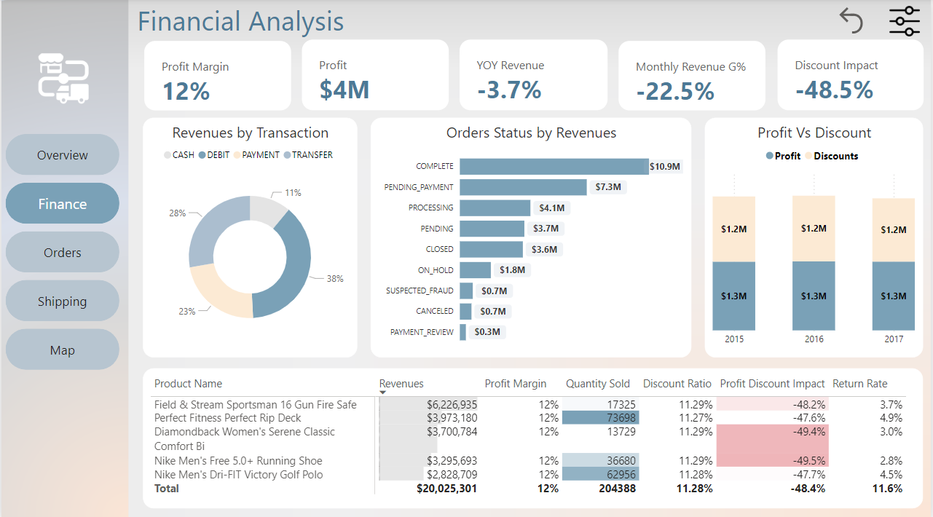
Finance Recommendations
Unplanned discounts may erode profits and hinder the company's ability to finance its operations or invest in growth.
Order management and resource allocation need improvement.
Improving efficiency in these processes will lead to faster conversion of pending orders into closed ones, accelerating revenue realization.

Slide 19
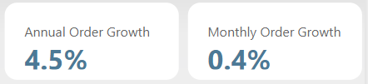
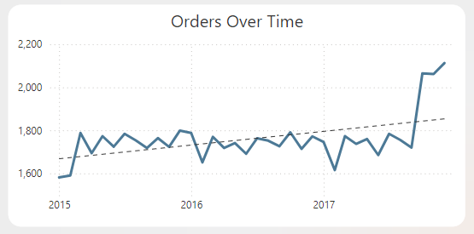
Orders Insights
Orders in the current year have grown by 4.5% compared to the previous year, indicating healthy year-over-year progress.
Orders in the current month have grown by 0.4% compared to the previous month, demonstrating consistent progress.
According to the line chart, orders have
significantly increased over
the last three months.

Slide 20
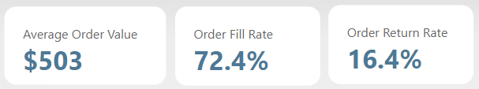
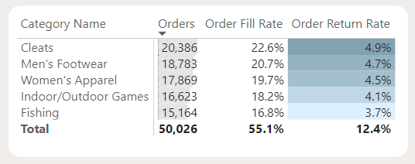
Orders Insights
Average Order Value is $503
The Order Fill Rate is 72.4%,
indicating that 72.4% of orders
were completely fulfilled. This
rate is moderate but can be
improved for better efficiency.
The Order Return Rate is 16.4%.
This rate is relatively high and
suggests a need for investigation
to reduce returns.

Slide 21
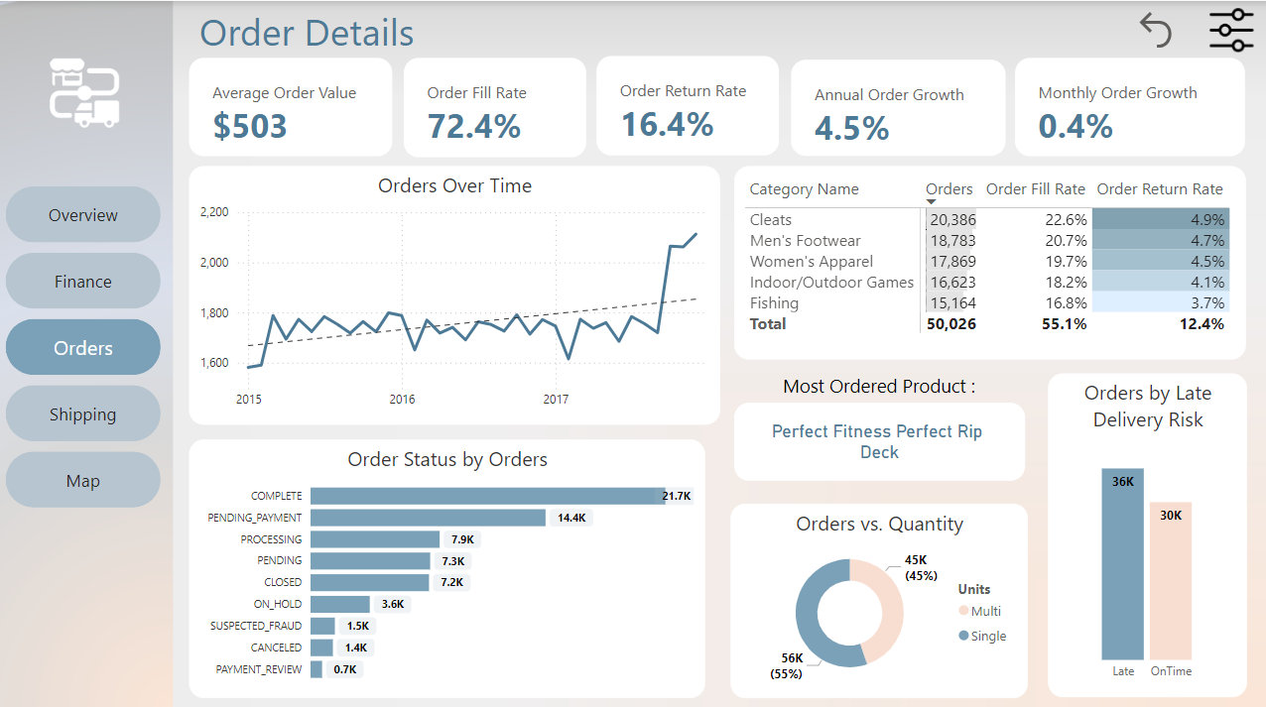
Orders Recommendations
Majority of orders are delayed: This indicates inefficiencies. To improve, optimize logistics and enforce stricter processing timelines.
55% of orders are for single units: This suggests lower sales volume. Encourage larger orders with promotions and bulk discounts.

Slide 22
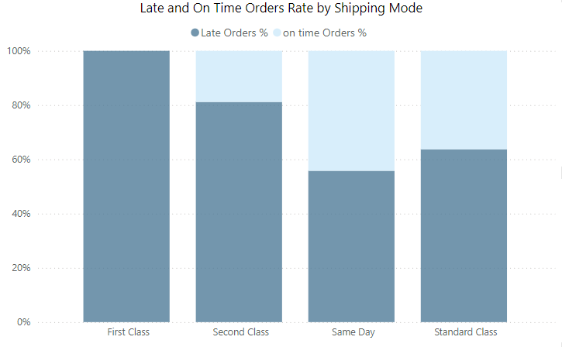

Shipping Insights
First Class: 100 % of orders arrive
late.
Second Class : The Late rate is much higher than the on-time rate 81.16%:18.84%.
Same Day : The Late rate is high which is a concern as it should be the best way 55.8% : 44.2%.
Standard Class : Top Shipping Mode on Time Rate 63.68% : 36.32% .

Slide 23
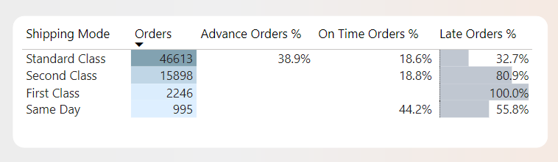
Shipping Insights
Best shipping mode is Standard Class.
It is the only way to deliver orders 38.9% ahead of schedule.
With the lowest Late rate of 32.7%.
Worst choice is First Class 100% of orders deliver late.

Slide 24
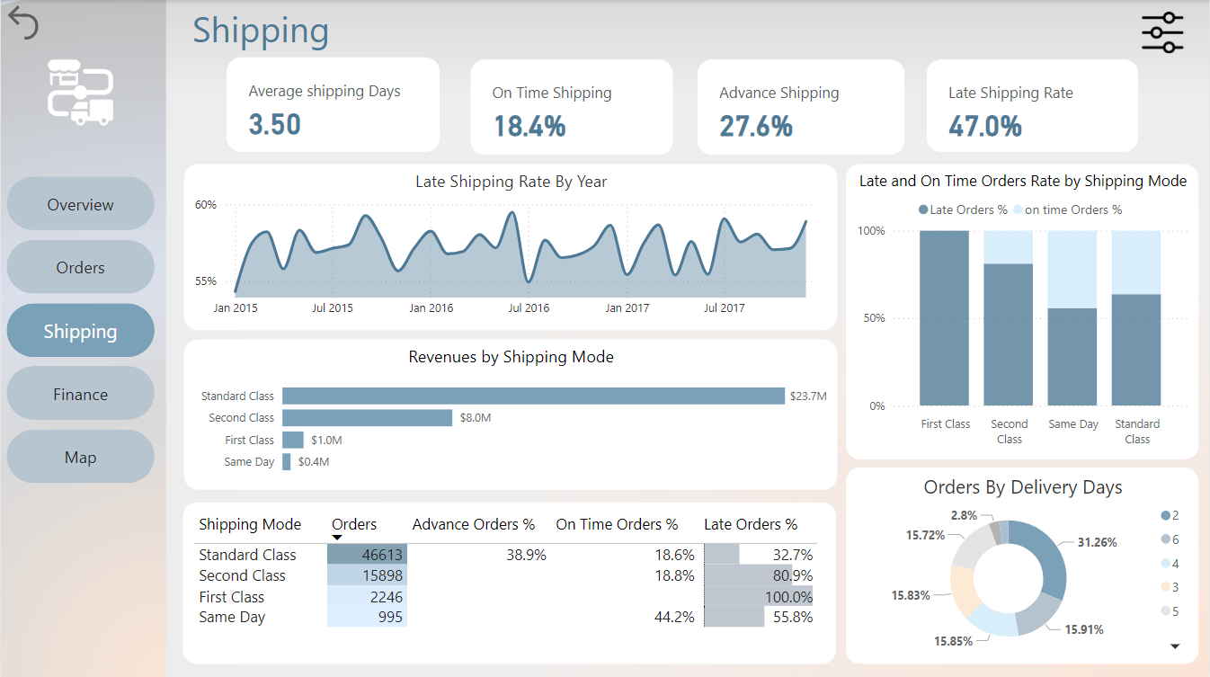
Shipping Recommendations
We need to improve First Class as the delay rate and associated risks are significantly high.
Use Standard Class for urgent orders and focus on further improvements.
Improve Same Day service as it should be the top choice to reduce delays and risks.

Slide 25
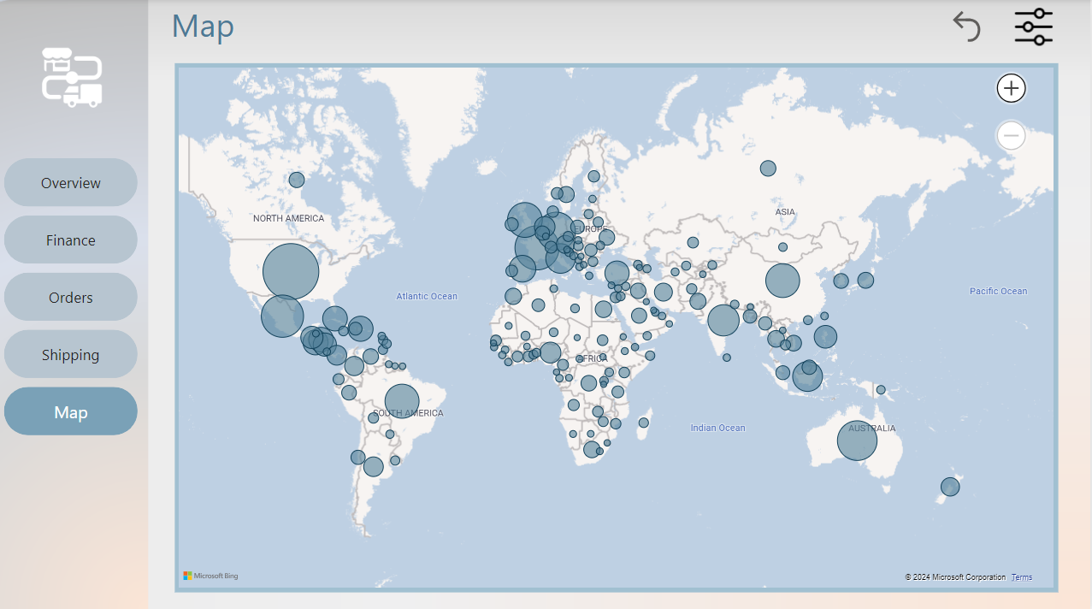
Map Insights
The company distributes orders to 23 regions across the globe.
The highest Region is Western Europe
with Total Orders 10K.
The United States leads with 8,270 orders, $4.39M in revenue, $540K profit, but only an 11.9% On-Time delivery rate.

Slide 26
Recommendations Summary
Implement advanced order and inventory management systems to improve operational efficiency.
Invest in improving shipping and storage processes to ensure better OTIF (On Time In Full) rates and reduce costs associated with delays.
Improve pricing and discount policies.

Slide 27



Thank You

